Slide 1
Cover Letter
Dual reporting:
eDMR: for test end date,
provide pass or fail result
ATB: Email signed AT Form
Final Result
Email signed
AT form to state

Slide 2
AT Form
ORC Sign Form
and provide email address
Form provides a summary
of the test information
provided on the
laboratory bench sheets

Slide 3
Ceriodaphnia
Bench Sheets
Control
Test

Slide 4
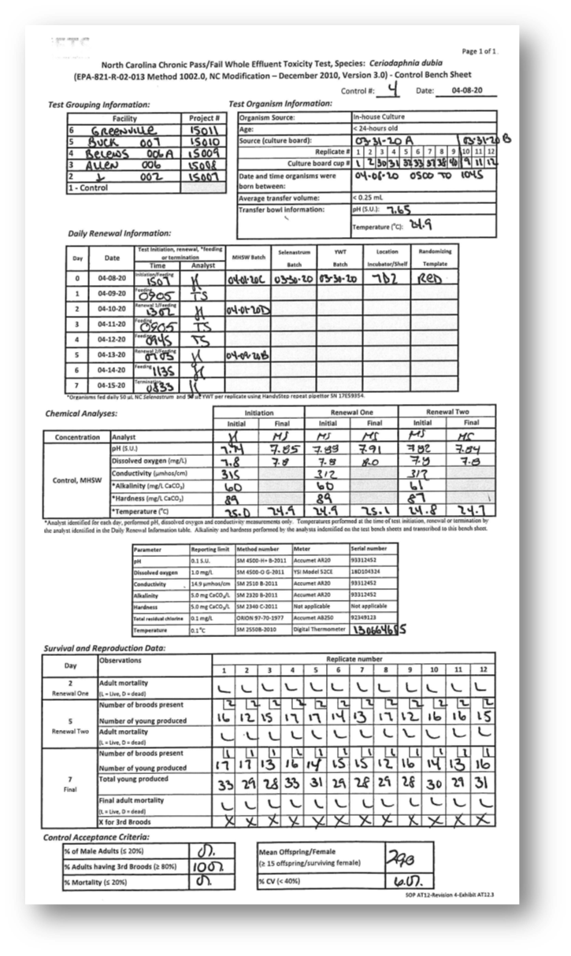
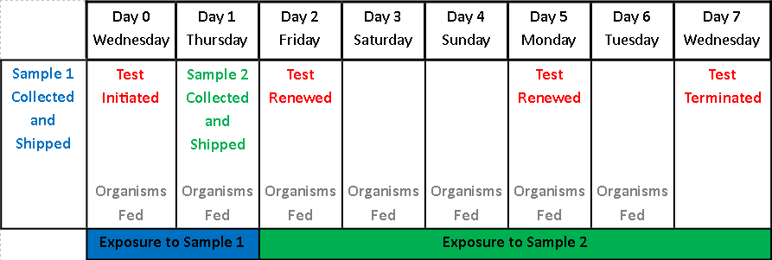
Renewal Information
Control Bench Sheet
Date, time and analyst that worked on test

Slide 5
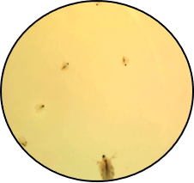
Ceriodaphnia Chronic Test
Bench Sheet
Control Bench Sheet
Test Cup
Survival recorded and number of offspring counted
each time test solutions are renewed

Slide 6
Control Organisms Acceptance Criteria
Control Bench Sheet
Organisms < 24-hours old
and born within 8-hour period
Survival and reproduction requirements

Slide 7
Control Water Acceptance Criteria
≤ 14 days old
Control Bench Sheet
Temperature = 24.0 – 26.0ºC
pH = 6.5 – 8.5 S.U.
Hardness = 80 – 100 mg/L CaCO₃

Slide 8
Effluent Sample
Test Bench Sheet
Permit specifications
Chemical analyses
pH = 6.0 – 9.0 S.U.
Dissolved Oxygen
> 5.0 mg/L
Chlorine
< 0.10 mg/L
Statistics: PASS or FAIL

Slide 9
Control Bench Sheet
Statistics
Test Bench Sheet
Program
used to compare survival and reproduction
in the Control
to the Test

Slide 10
Statistics
No significant
difference
= “PASS”

Slide 11
Double Entry and Confirmation
% Reduction
< 20% = PASS
Survival < 67% = FAIL

Slide 12
Reference Toxicant Testing
Sensitivity of organisms over time
Credibility of testing system
Evaluate testing personnel

Slide 13
Reference Toxicant Control Chart
Last data point indicates sensitivity of organisms near the time your test was performed

