Slide 1
Whole Effluent Toxicity (WET) Methods
Determines
the toxic effect
from all pollutants contained in a
facility’s discharge
to aquatic organisms

Slide 2
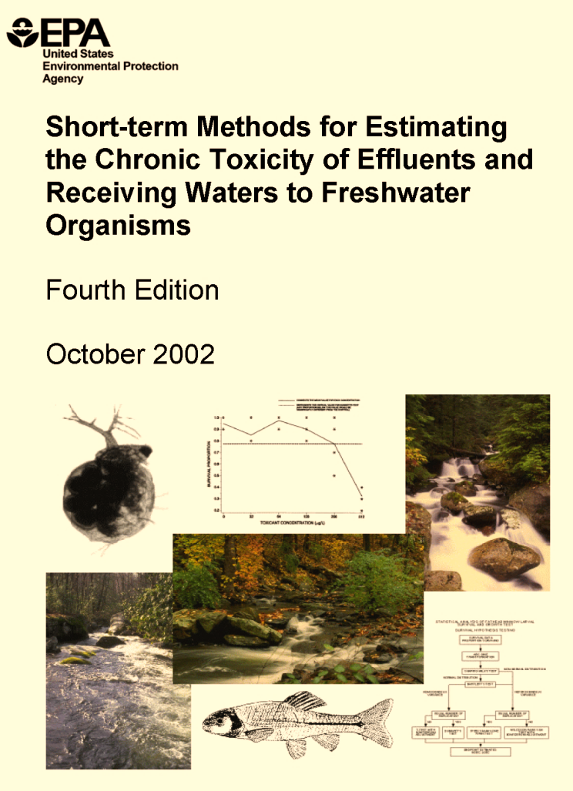
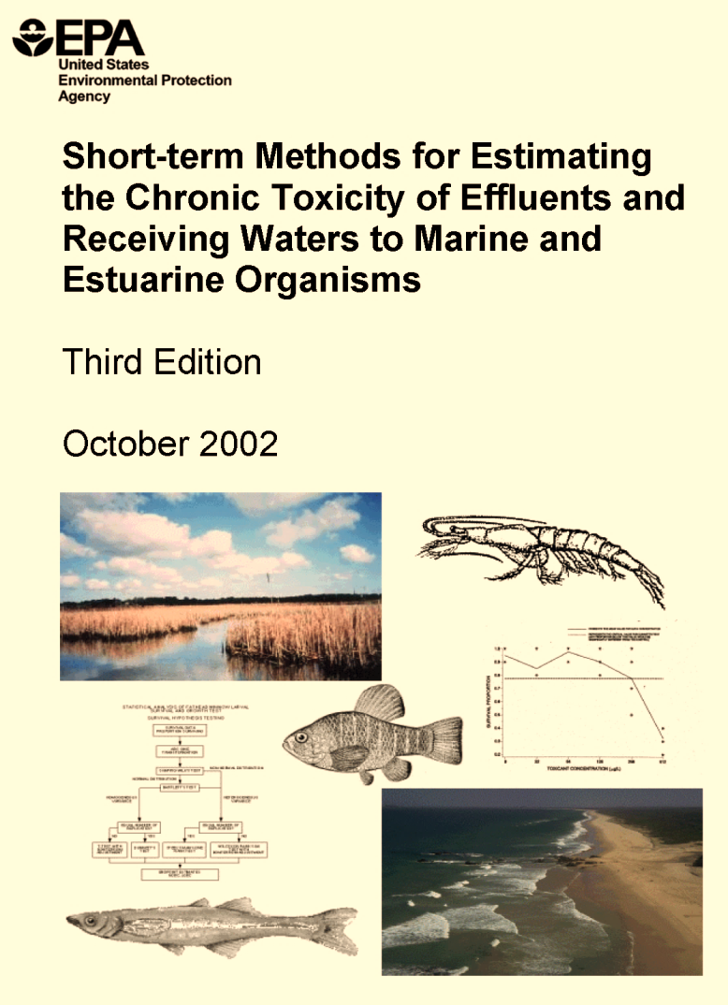
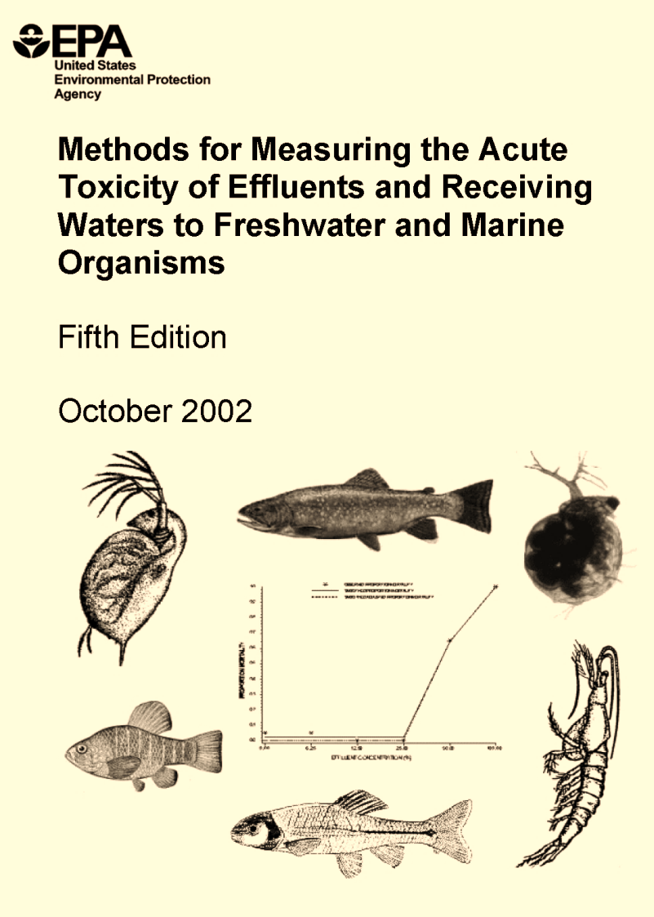
Whole Effluent Toxicity (WET) Methods
Methods measure
the ability
of an organism
to survive,
grow and reproduce

Slide 3
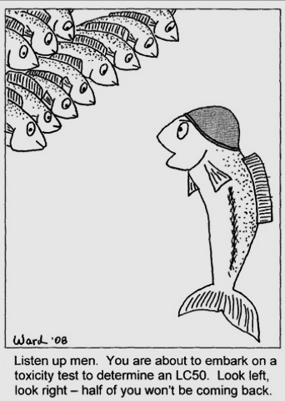
Acute Toxicity
Short-term exposure
24 or 48 hours
Evaluating 1 sample

Slide 4
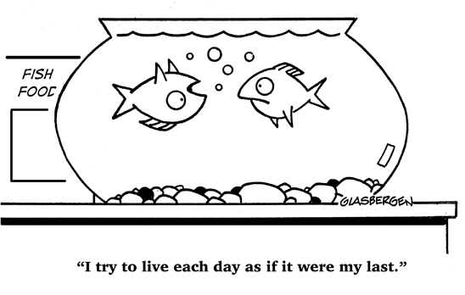
Chronic Toxicity
Long-term exposure
7 days
Evaluating
2 or 3 samples

Slide 5
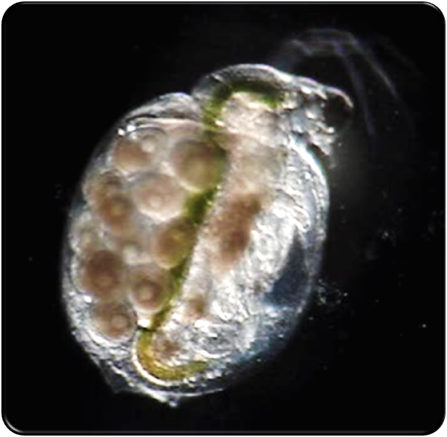
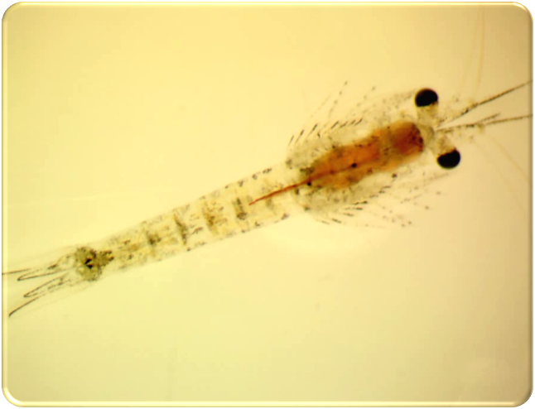
Invertebrates
Water flea
Ceriodaphnia dubia
Mysid shrimp
Americamysis bahia

Slide 6
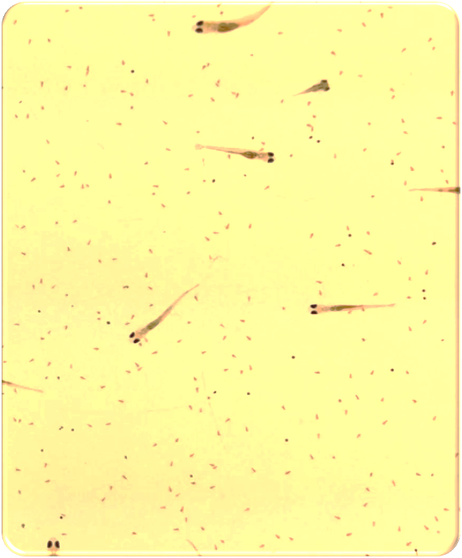
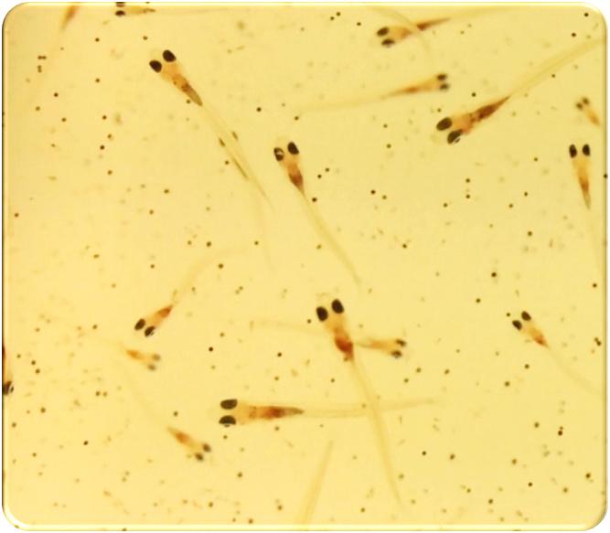
Vertebrates
Fathead minnows
Pimephales promelas
Inland silversides
Menidia beryllina

Slide 7
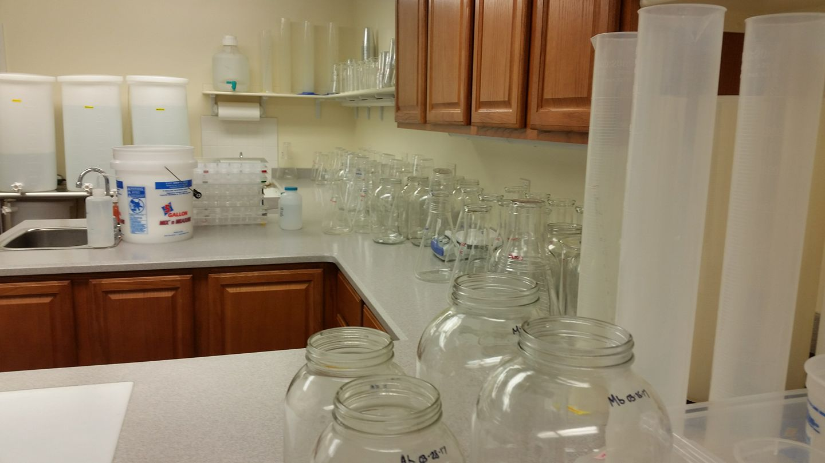
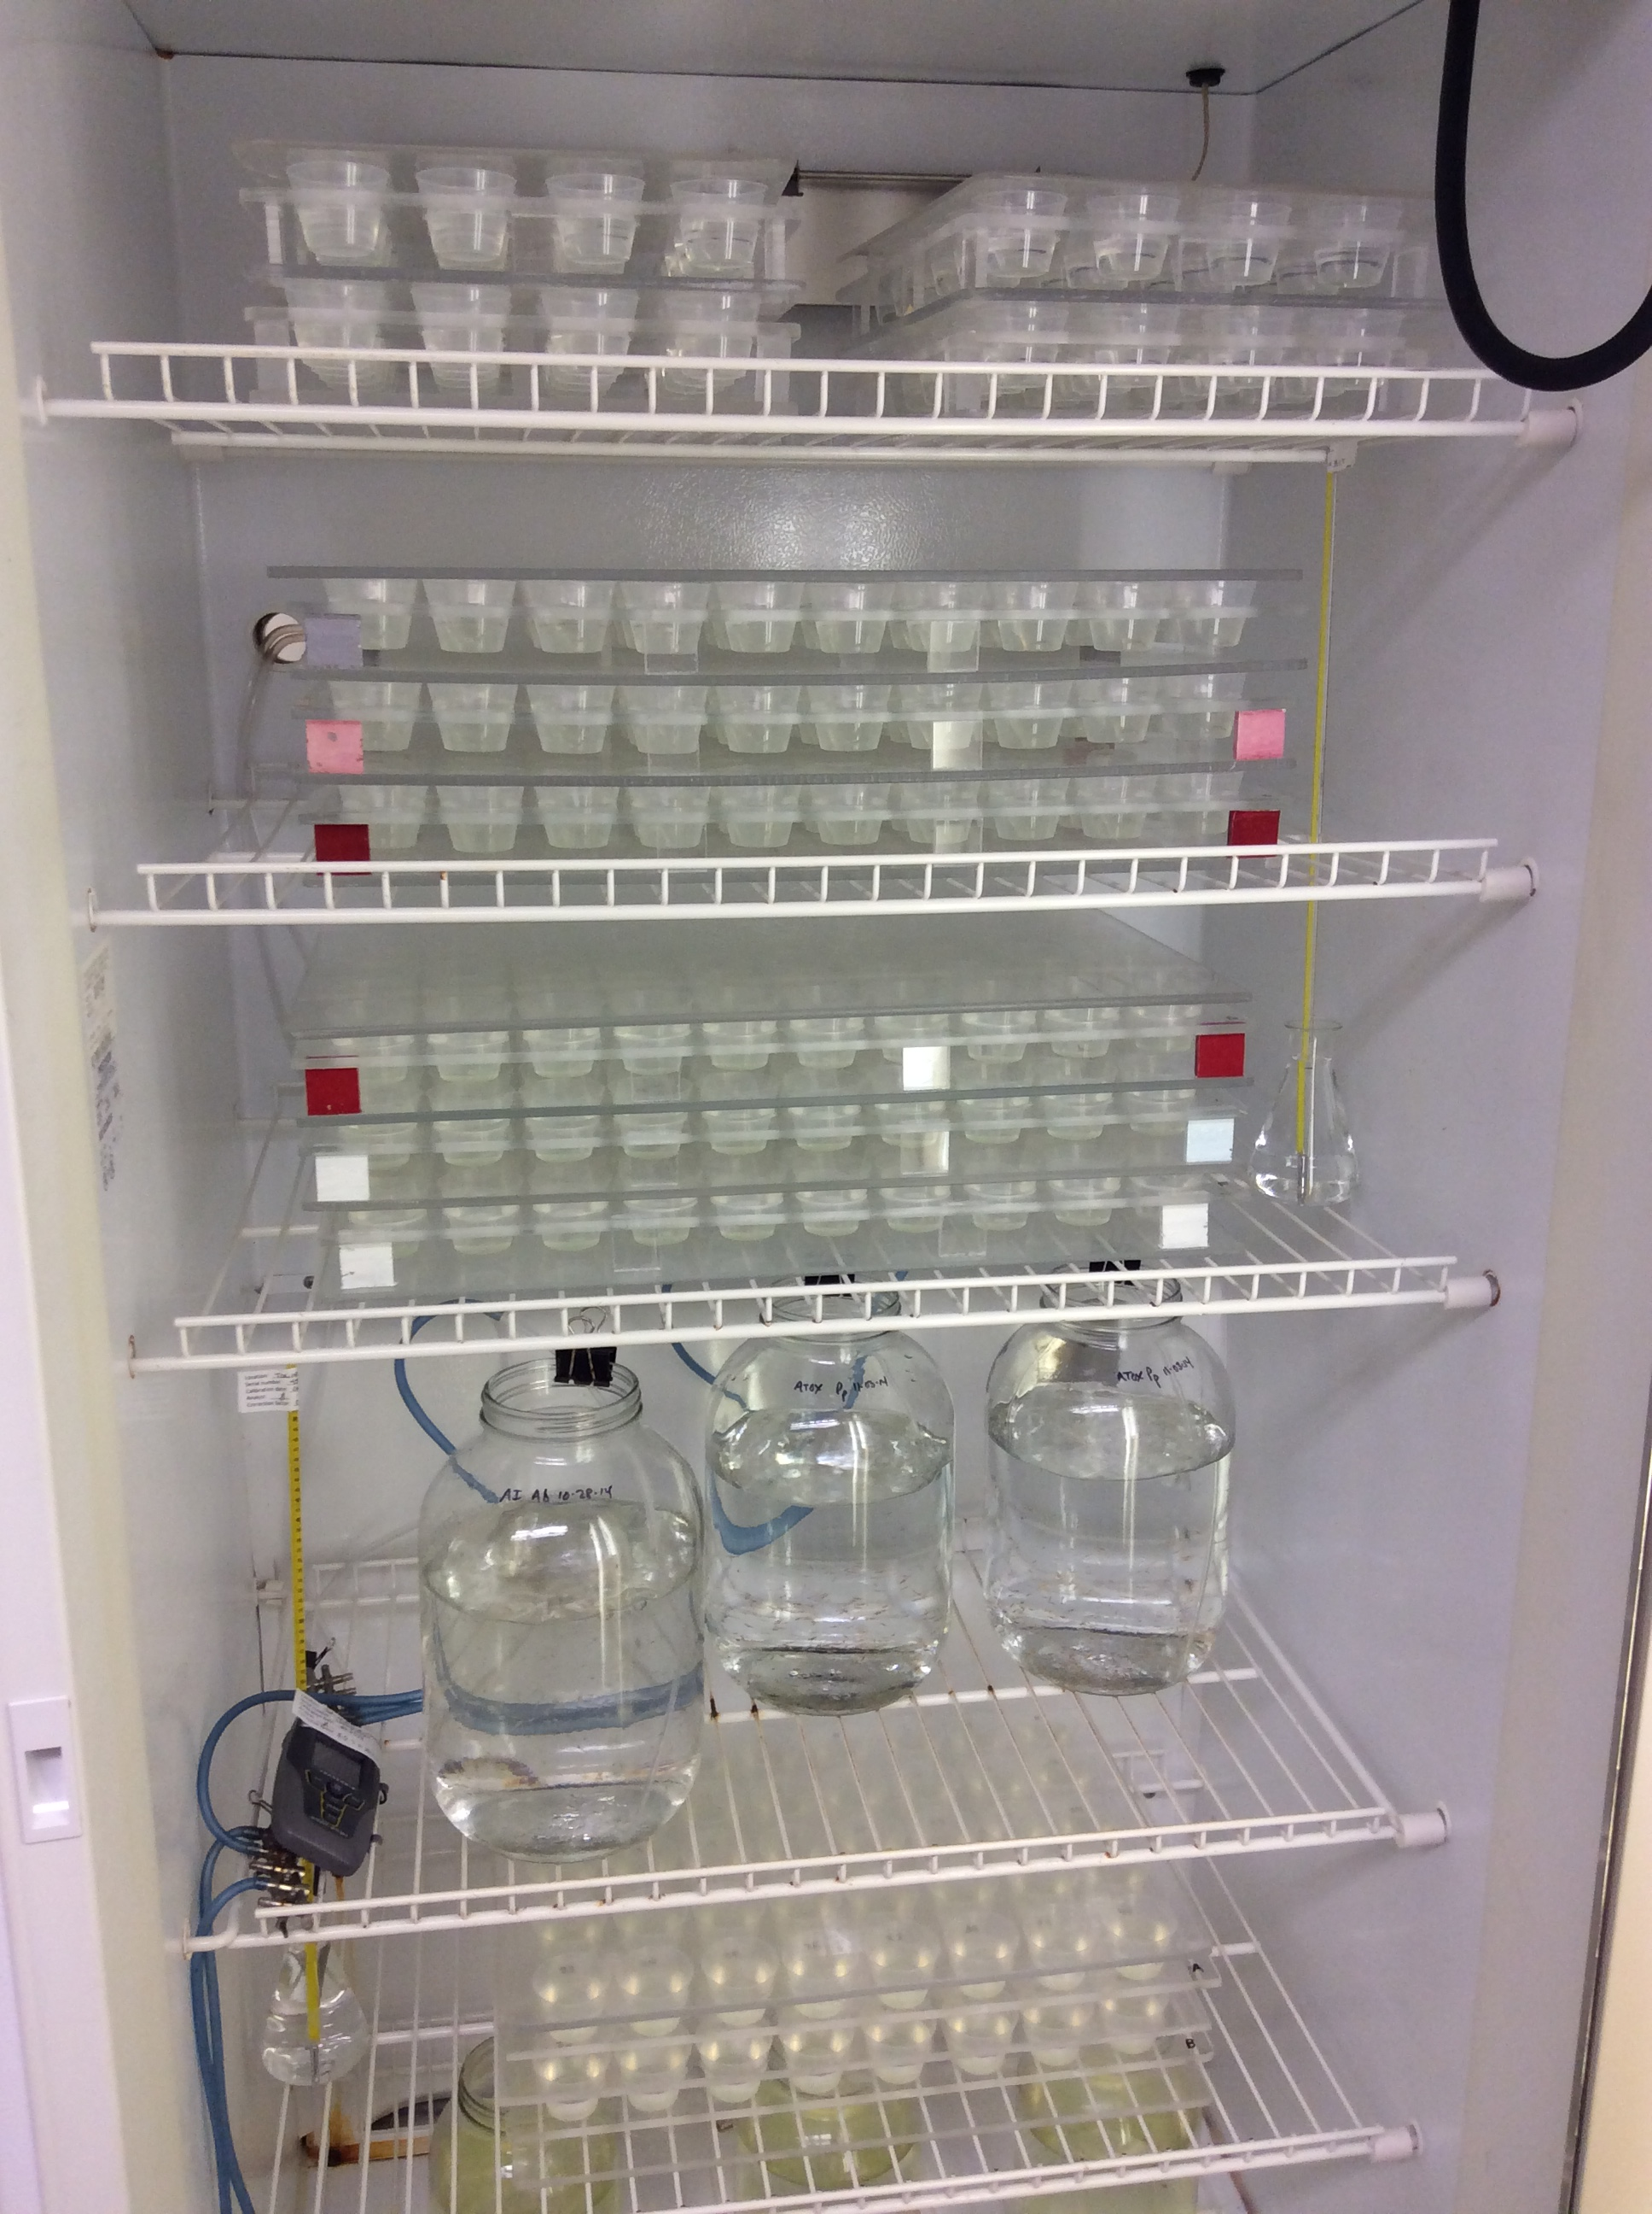
Scheduling
Enough space / glassware for testing
Number of organisms needed
Salt water organisms are purchased
and each batch needs to be QC checked
Research testing
Reporting deadlines

Slide 8
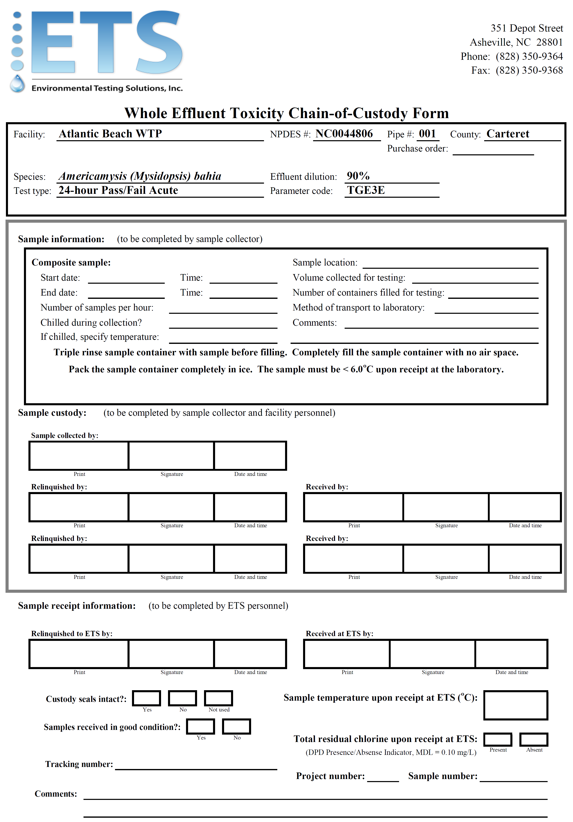
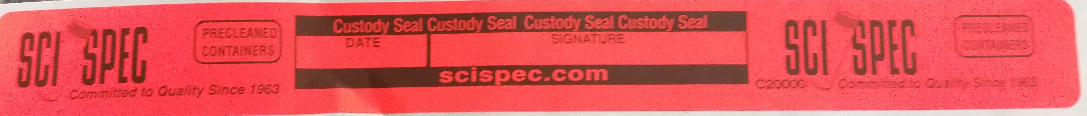
Sample Kits
Did you receive your kit?
When you get your kits,
make sure you have
everything you need!
  In each cooler:
      Zip lock bag
      Instructions
      Chain-of-Custody
      Custody Seals
      Return Shipping Label
      Trash Bag
      Cubitainer(s)

Slide 9
Make sure
the test information we have is correct!
Correct any information that may be wrong.
This is what we use to know what testing to perform.

Slide 10
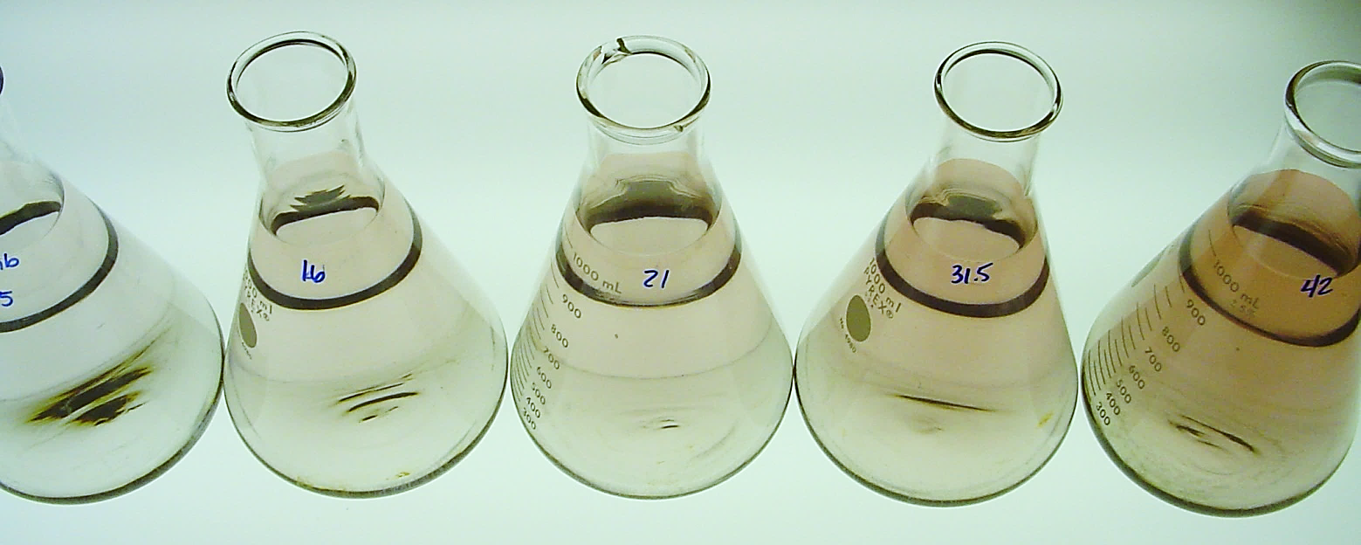
Sample Preparation
Aliquot warmed to 25.0 ± 1.0ºC
Sample diluted to permit limit
For pass/fail chronic test dilution preparation:
1.6% limit: 4.8 mL effluent + 295.2 mL laboratory water
23.6% limit: 70.8 mL effluent + 229.2 mL laboratory water

Slide 11
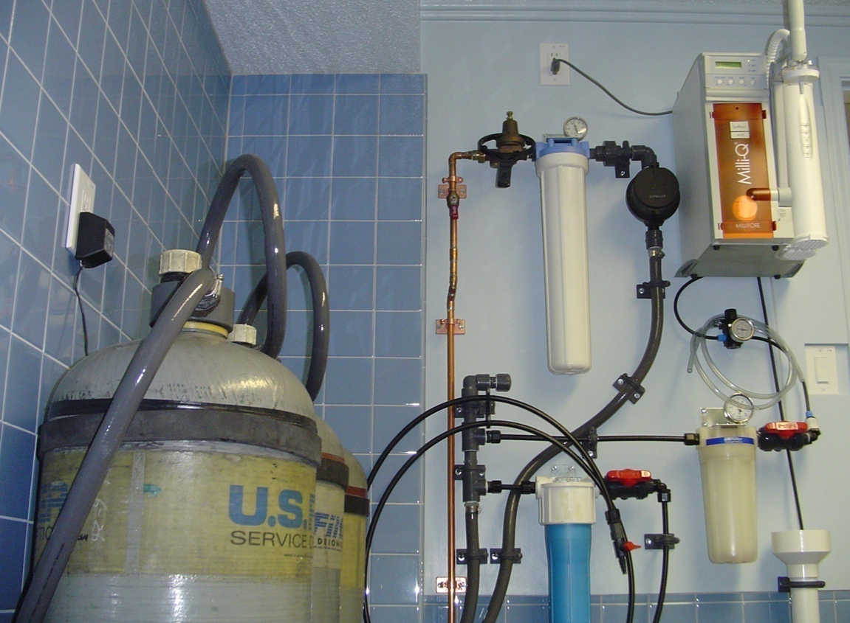
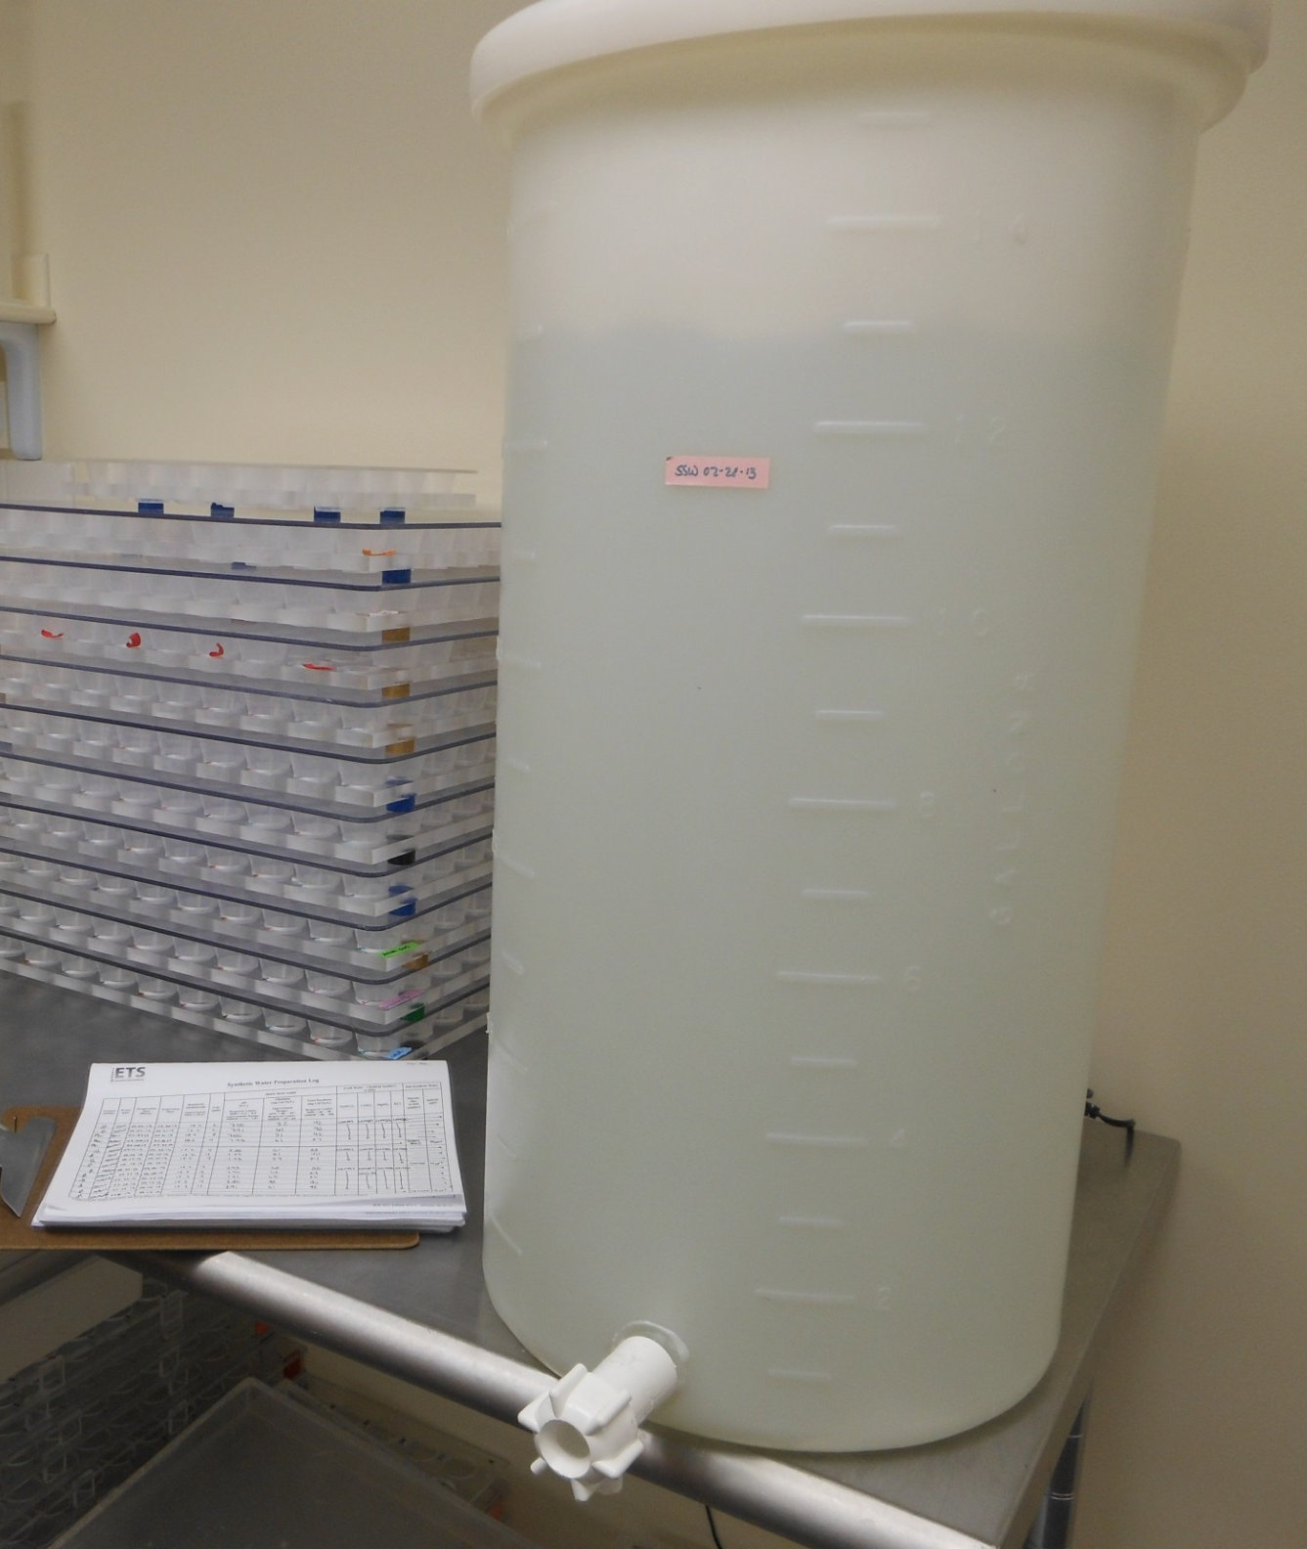
Dilution Water
Deionized water
with salts added

Slide 12
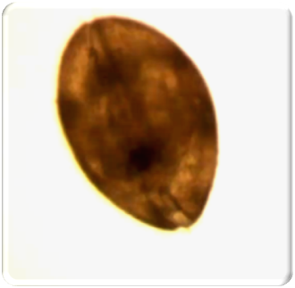
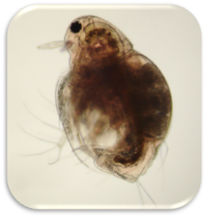
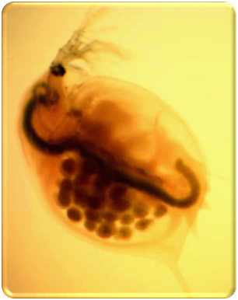
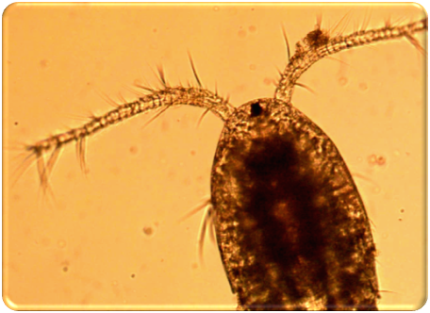
If Present,
Other Organisms
Removed
Ostracod
Moina
Competition
for food
Confusion with
testing organisms
Daphnia
Copepod

Slide 13
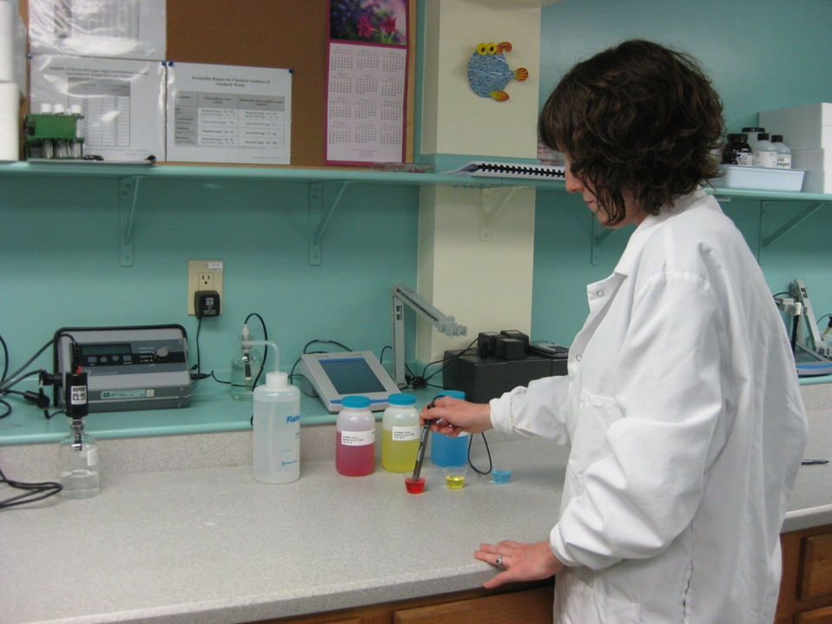
Basic Chemical Analyses
pH
Dissolved Oxygen
Conductivity
Salinity
Total Residual Chlorine

Slide 14
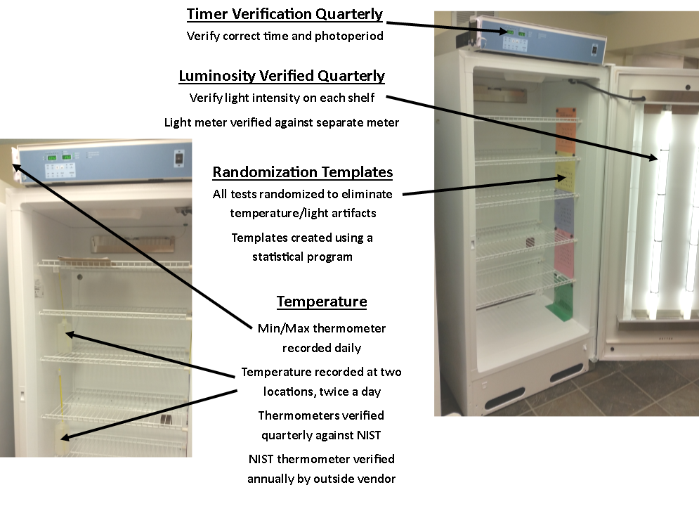
Controlled
Test
Conditions
25.0 ± 1.0ºC
16-hours light
8-hours dark
Light
50–100 ft-c
Randomized

Slide 15
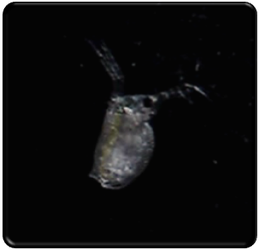
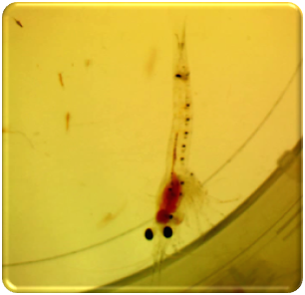
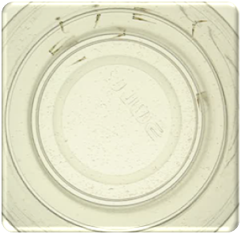
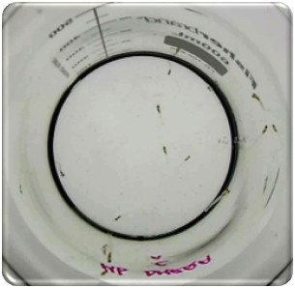
Organism Age
Varies to target either
a specific developmental stage
or sensitive time period
Ceriodaphnia
< 24-hours old
Mysid shrimp
Acute: 1-5 days old
Chronic: 7-days old
Fathead minnows
Acute: 1-14 days old
Chronic: < 24-hours old
Inland silversides
Acute: 9-14 days old
Chronic: 9-11 days old

Slide 16
Test Conditions
Ceriodaphnia Acute | Pass/Fail | Full-range
Concentrations tested | 1 | 5
Replicates | 4 | 4
Number of organisms per replicate | 10 | 5
Minnow and Mysid Acute | Pass/Fail | Full-range
Concentrations tested | 1 | 5
Replicates | 4 | 2
Number of organisms per replicate | 10 | 10
Varies with each
type of test
to give the best
statistical comparison
Ceriodaphnia Chronic | Pass/Fail | Full-range
Concentrations tested | 1 | 5
Replicates | 12 | 10
Number of organisms per replicate | 1 | 1
Minnow Chronic | Pass/Fail | Full-range
Concentrations tested | 1 | 5
Replicates | 4 | 4
Number of organisms per replicate | 10 | 10
Mysid Chronic | Pass/Fail | Full-range
Concentrations tested | 1 | 5
Replicates | 8 | 8
Number of organisms per replicate | 5 | 5

Slide 17
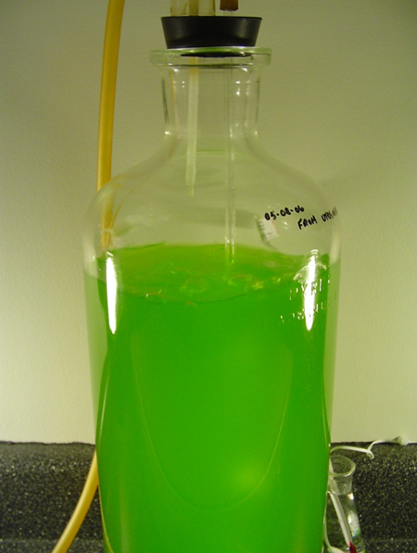
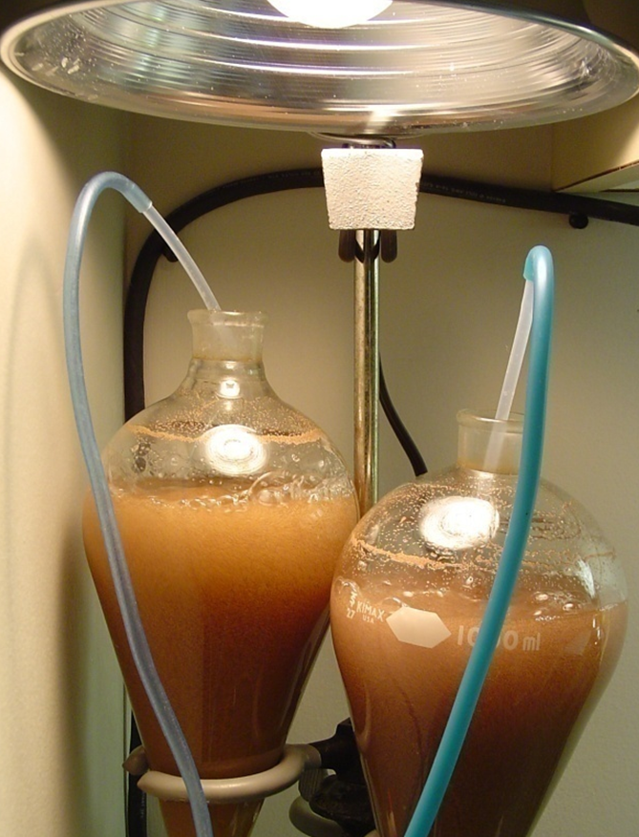
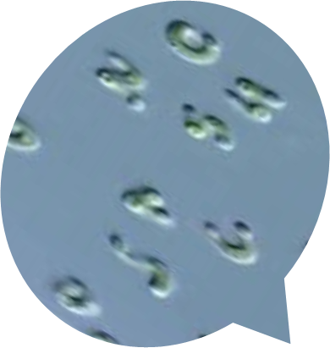
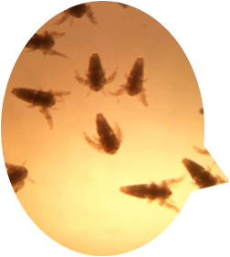
Feeding
Acute tests
are not fed
Algae
Artemia
Chronic tests
are fed daily

Slide 18
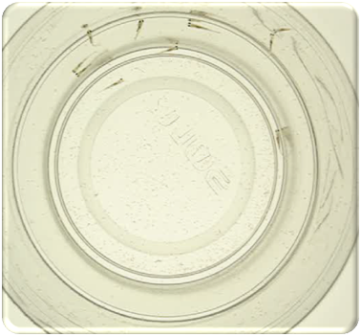
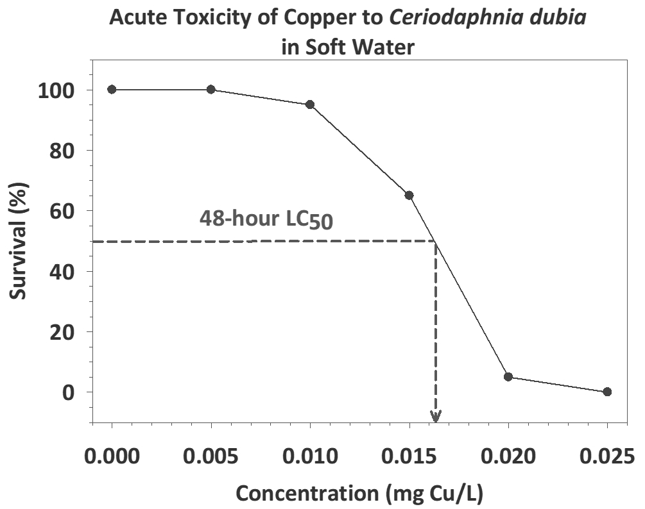
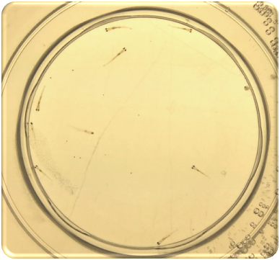
Acute Tests: Pass/Fail or LC₅₀
Control
Sample

Slide 19
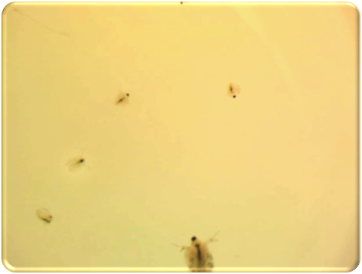
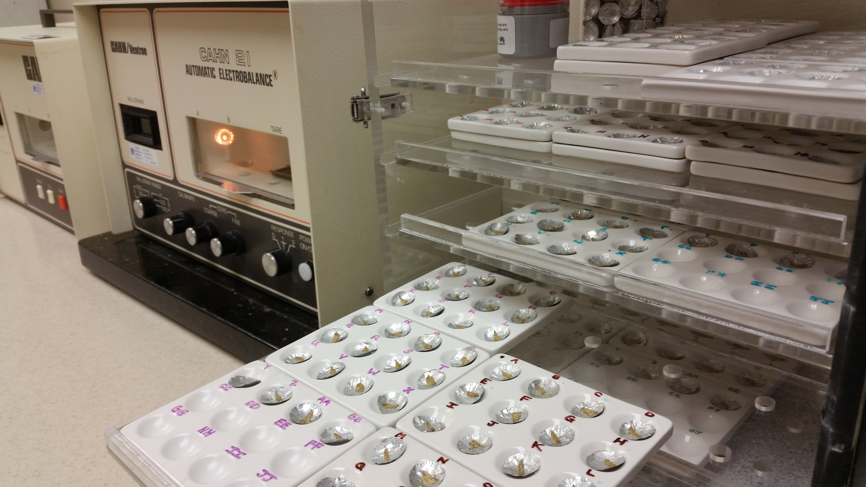
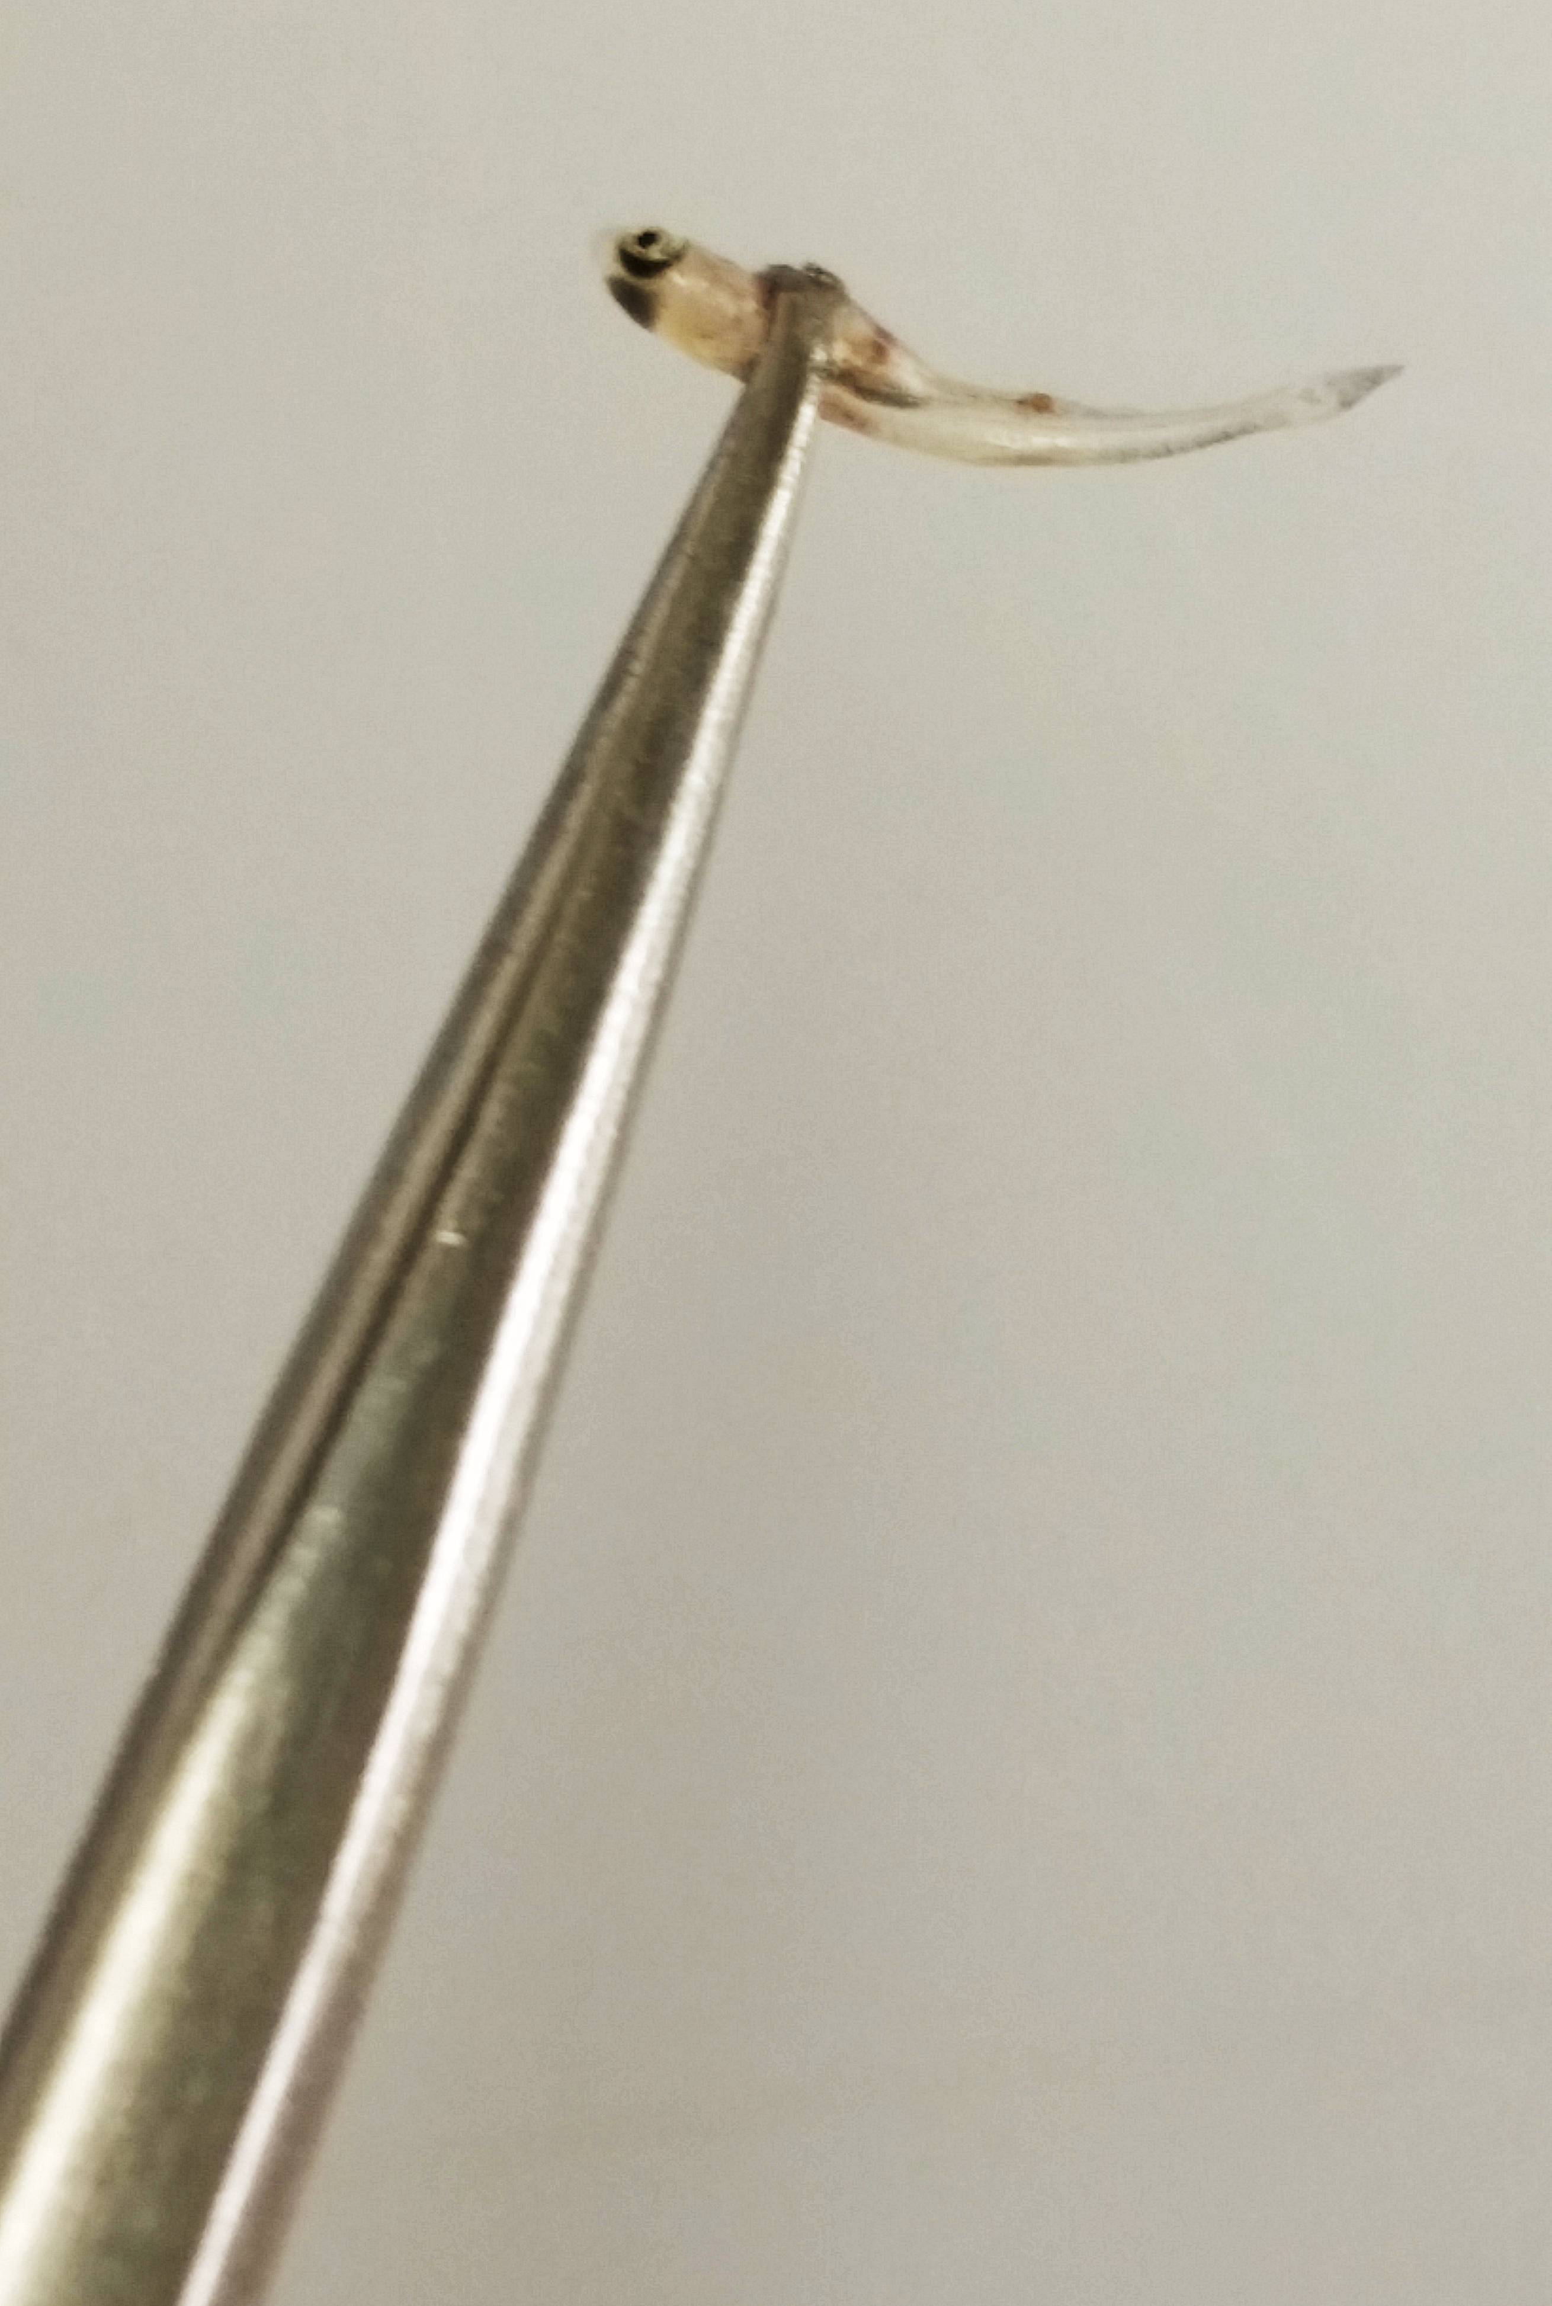
Ceriodaphnia Tests
Survival and Reproduction
Chronic Tests: Pass/Fail or Chronic Value (ChV)
Minnow and Mysid Tests
Survival and Growth

Slide 20
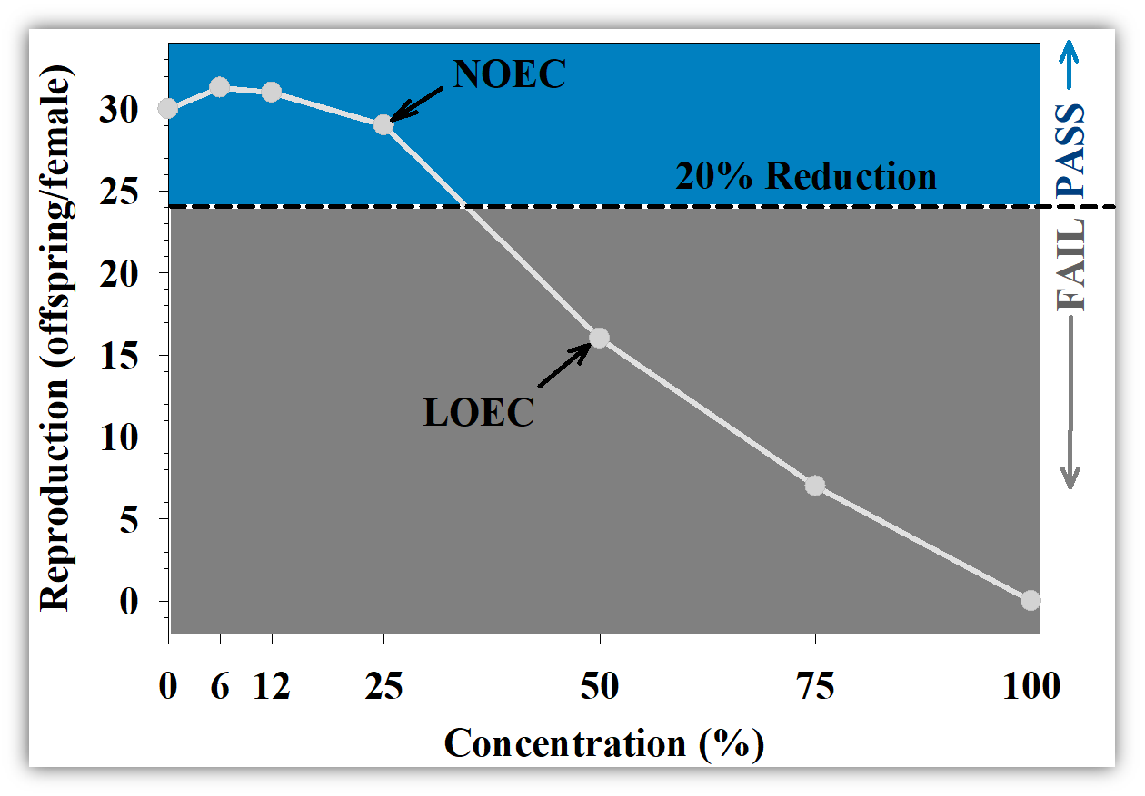
Chronic Tests: Pass/Fail or Chronic Value (ChV)
√___________
√______
ChV = NOEC x LOEC = 25 x 50 = 35.4%

Slide 21
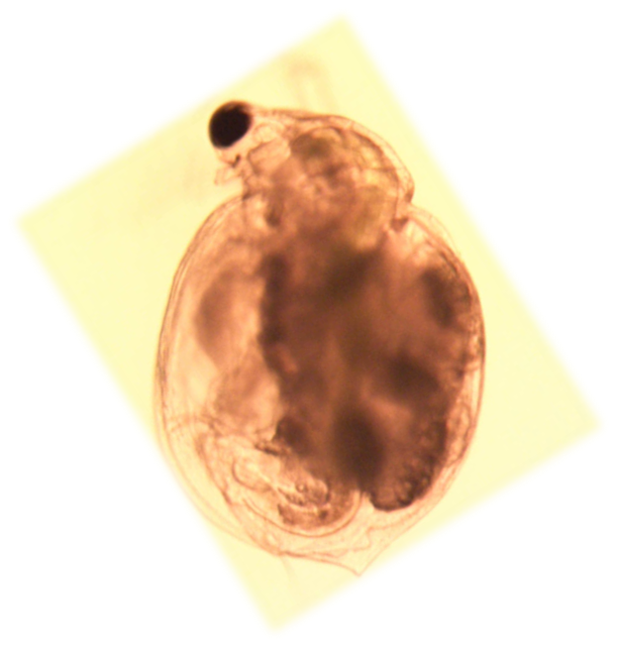
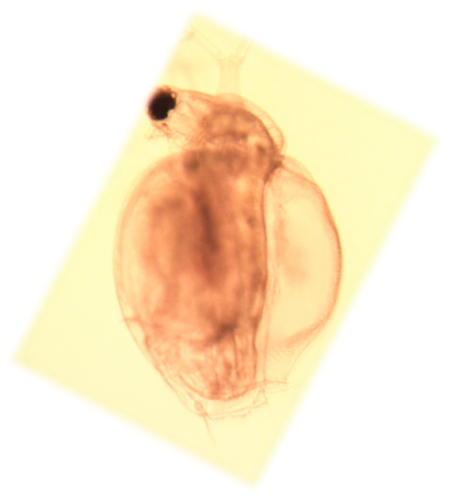
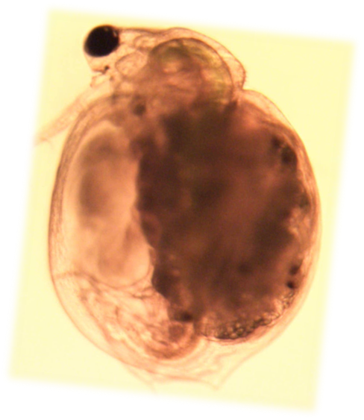
Toxicant Exposure with Ceriodaphnia
Healthy
Small
Clear

Slide 22
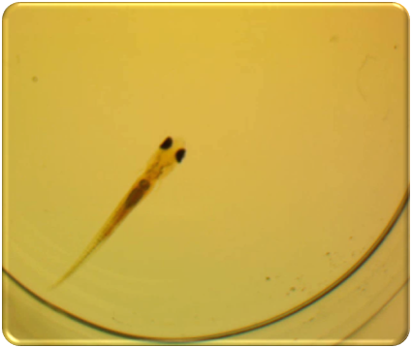
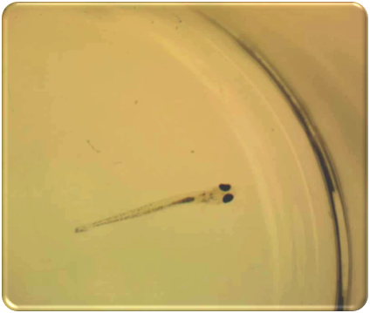
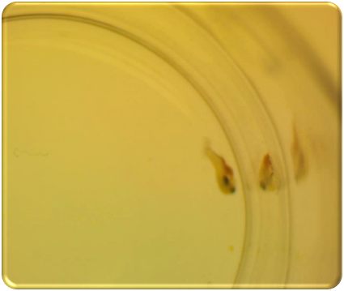
Toxicant Exposure with Minnows
Healthy
Small
Stressed

